Slide 1
Project 1.1

Slide 2
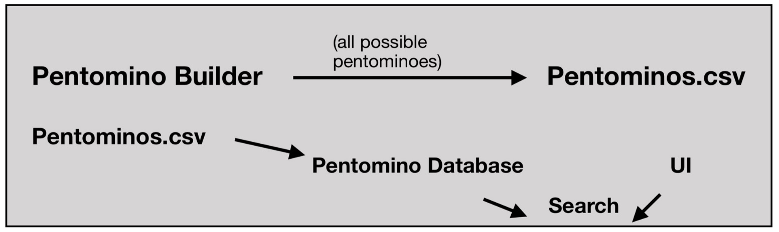
Relation between the parts of the programme

Slide 3
Main topics
Solutions to this task
Our process during the week
Statistics about the time efficiency of code
Failed experiment

Slide 4
Different solutions to the problem
Brute force
Recursion/Branching algorithm
Dancing links

Slide 5
Process during the week
Individual Research
Allocation of the tasks
Completion of the Brute force
Creation of the Branching algorithm

Slide 6
Branching and Brute Force Why branching is better ?
No randomness
More control
Only checking each pieces mutations once for each position.
We can control what order pieces get placed.

Slide 7
Pruning
Checking for overlap when placing a new piece
Try each position and mutation only once
CharacterToID moved to the main.
Try symmetrical pentominoes first
(5*9 grid / 16859ms -> 765ms)

Slide 10
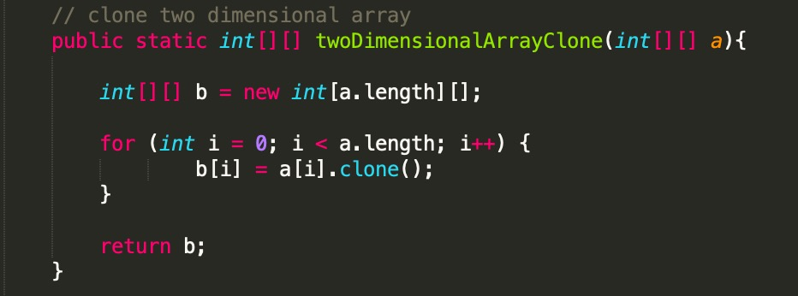
Failed experiment
Field copy – Clone the field instead of removing a piece
int[][]fieldCopy=twoDimensionalArrayClone(field);
If(!solution)
{field= fieldCopy; x++;}

Slide 11
Dancing links
Dancing links is the technique suggested by Donald Knuth
Finds a solution for the exact cover problem
Searching for 1s in selected rows and columns.
Sparse matrix

Slide 12
Conclusion

Slide 13
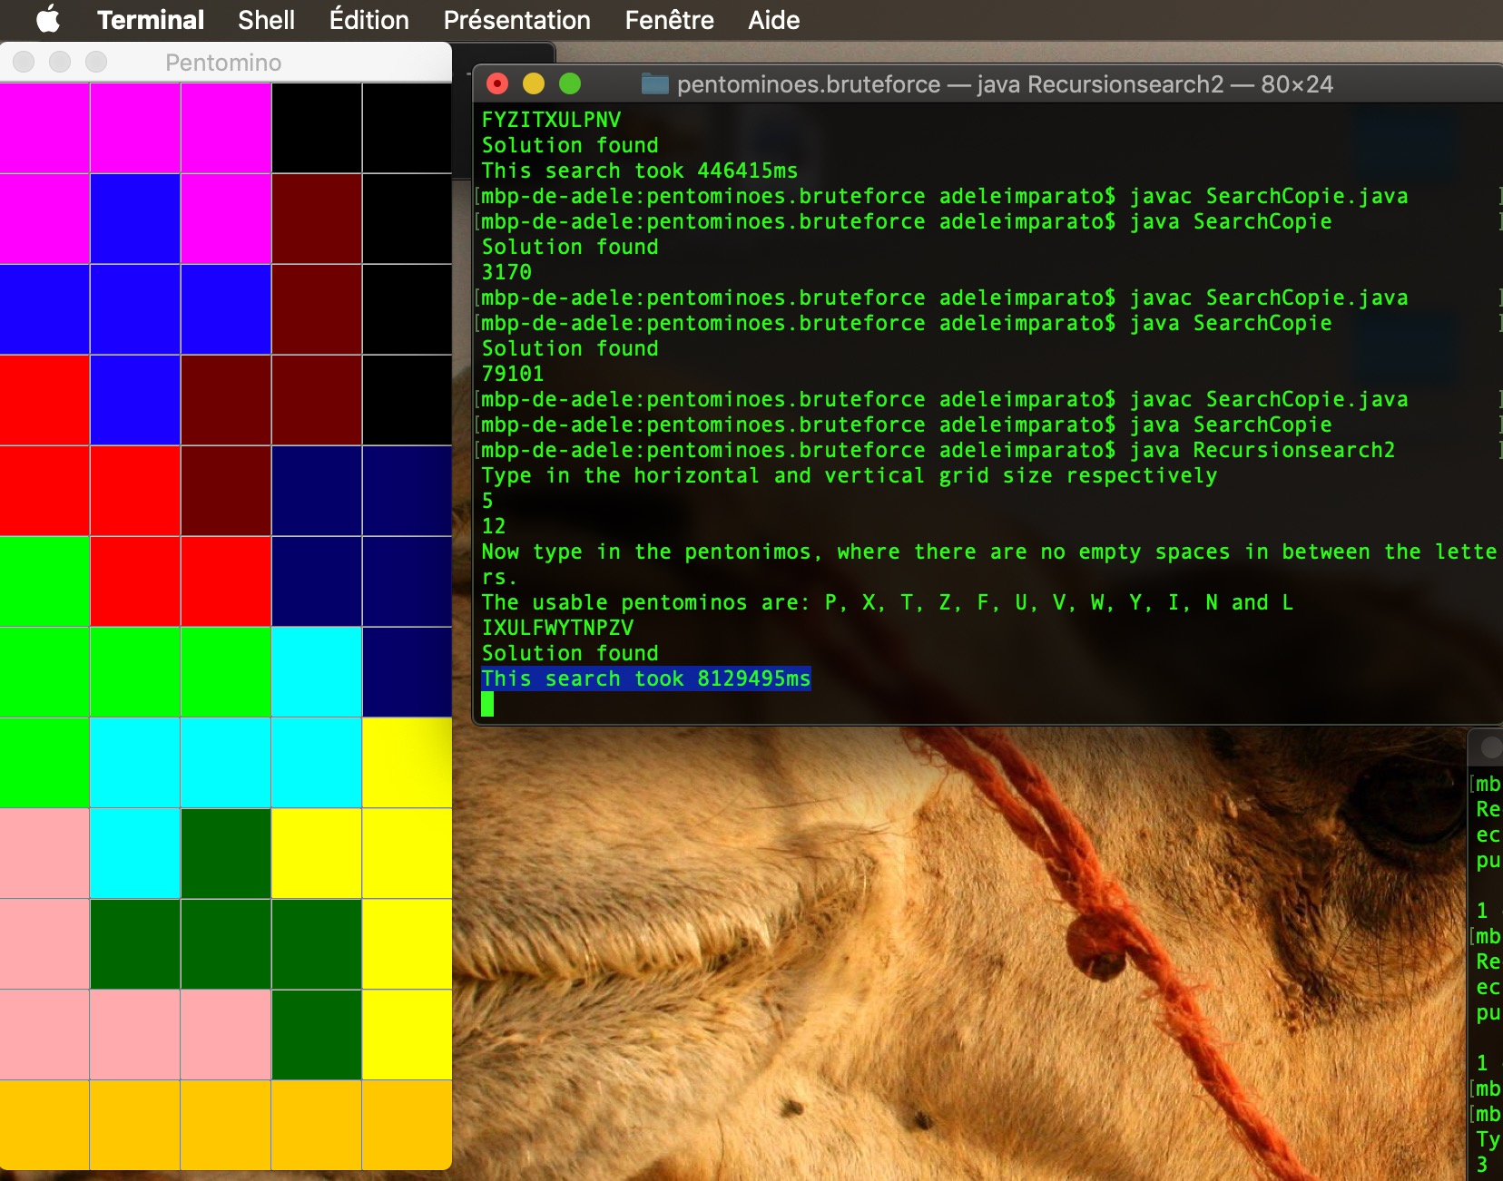
Time for 12x5 grid:
Before Pruning > 8 hours
After Pruning = 2hours 15 minutes

